Slide 1

Working with AJAX in Selenium

Slide 2
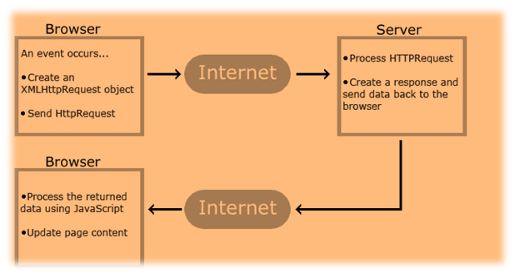
Introduction
AJAX stands for Asynchronous JavaScript & XML.
AJAX allows the Web page to retrieve small amounts of data from the server without reloading the entire page.
An Ajax call is an asynchronous request initiated by the browser that does not directly result in a page transition.
AJAX sends HTTP requests from the client to server and then process the server's response, without reloading the entire page.

Slide 3
Handling AJAX Call using Selenium
The biggest challenge in handling Ajax call is knowing the loading time for the web page. For resolving this problem selenium web driver using wait method on Ajax Call.
Following are the wait methods that Selenium Webdriver can use:-
1) Thread.Sleep()
It suspends the current thread for the specified amount of time.
Thread.sleep(t) makes the current thread to be moved from the running queue to the waiting queue.
After the time 't' reached, the current thread will move from the waiting queue to the ready queue, and then it takes some time to be picked by the CPU and be running.
2) Implicit Wait()
An implicit wait tells WebDriver to poll the DOM for a certain amount of time when trying to find an element if they are not immediately available.
The implicit wait is set for the life of the WebDriver object instance.

Slide 4
3) Explicit Wait()
Explicit wait is used to freeze the test execution till the time a particular condition is met or maximum time lapses.
4) WebdriverWait
It can be used for any conditions. This can be achieved with WebDriverWait in combination with ExpectedCondition.
The best way to wait for an element dynamically is checking for the condition every second and continuing to the next command in the script as soon as the condition is met.
5) Fluent Wait
FluentWait determines the maximum amount of time to wait for a condition, as well as the frequency with which to check the condition.

Slide 5
Challenges in Handling Ajax Call
Using "pause" command for handling Ajax call is not completely reliable. Long pause time makes the test unacceptably slow and increases the Testing time. Instead, "waitforcondition" will be more helpful in testing Ajax applications.
It is difficult to assess the risk associated with particular Ajax applications.
Creating automated test request may be difficult for testing tools as such AJAX application often use different encoding or serialization technique to submit POST data.

Slide 6
Example of handling AJAX call using Selenium
Now see the code here :-
import org.openqa.selenium.By;
import org.openqa.selenium.WebDriver;
import org.openqa.selenium.WebElement;
import org.openqa.selenium.chrome.ChromeDriver;
import org.openqa.selenium.support.ui.ExpectedConditions;
import org.openqa.selenium.support.ui.WebDriverWait;
import org.testng.Assert;
import org.testng.annotations.BeforeClass;
import org.testng.annotations.Test;
public class Ajaxdemo {
private String URL = BASE URL;
WebDriver driver;
WebDriverWait wait;
@BeforeClass
public void setUp() {
System.setProperty("webdriver.chrome.driver",".\\chromedriver.exe");

Slide 7
//create chrome instance
driver = new ChromeDriver();
driver.manage().window().maximize();
driver.navigate().to(URL);
}
@Test
public void test_AjaxExample() {
By container = By.cssSelector(".container");
wait = new WebDriverWait(driver, 5);
wait.until(ExpectedConditions.presenceOfElementLocated(container));
//Get the text before performing an ajax call
WebElement noTextElement = driver.findElement(By.className("radiobutton"));
String textBefore = noTextElement.getText().trim();
//Click on the radio button
driver.findElement(By.id("yes")).click();
//Click on Check Button
driver.findElement(By.id("buttoncheck")).click();
/*Get the text after ajax call*/
WebElement TextElement = driver.findElement(By.className("radiobutton")); wait.until(ExpectedConditions.visibilityOf(TextElement));
String textAfter = TextElement.getText().trim();

Slide 8
/*Verify both texts before ajax call and after ajax call text.*/
Assert.assertNotEquals(textBefore, textAfter);
System.out.println("Ajax Call Performed");
String expectedText = "Radio button is checked and it's value is Yes";
/*Verify expected text with text updated after ajax call*/
Assert.assertEquals(textAfter, expectedText);
driver.close();
}
}

Slide 9
Covered Till Now
AJAX allows the Web page to retrieve small amounts of data from the server without reloading the entire page.
To test Ajax application, different wait methods should be applied
ThreadSleep
Implicit Wait
Explicit Wait
WebdriverWait
Fluent Wait
Creating automated test request may be difficult for testing tools as such AJAX application often use different encoding or serialization technique to submit POST data.

Slide 10
Thanks

